Slide 1
TITLE : CASINO SLOT GAME
GAME NAME :
FRUIT KING
NAME : AYUSH VAISH
COURSE : B.VOC SOFTWARE DEVELOPMENT
REPOSITORY LINK:CLICK HERE

Slide 2
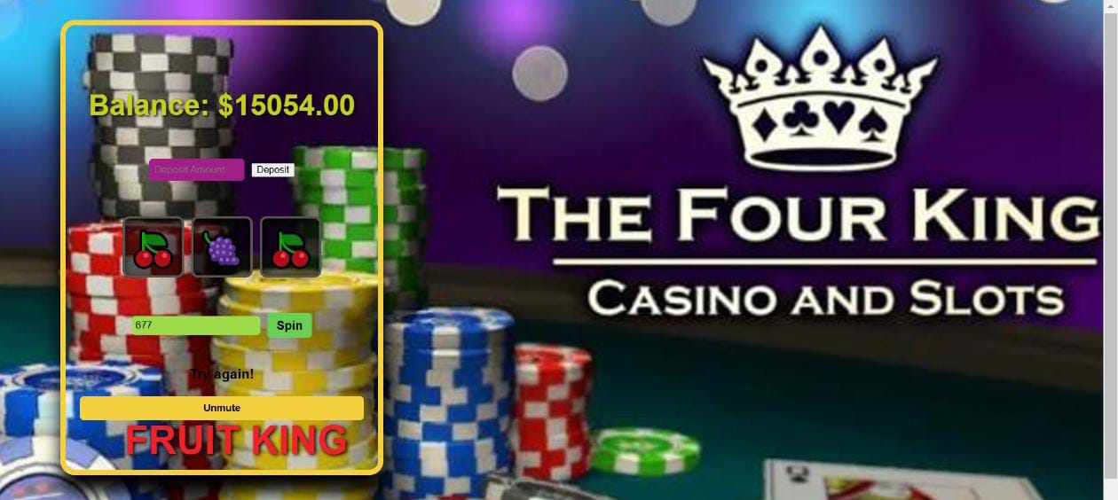
INTRODUCTION
Heading: What is the Casino Slot Game?
A web-based slot machine game built using HTML, CSS, and JavaScript.
Simulates a classic casino experience with dynamic reels, balance management, and audio effects.

Slide 3
FEATURES
1
🎡 Dynamic Reels: Random outcomes ensure unpredictability.
2
💰 Balance System: Deposit funds, bet, and manage your balance.
3
🔊 Audio Effects: Engaging sounds for spins, wins, and losses.
4
📱 Responsive Design: Works seamlessly on desktops and mobile devices.
5
🎨 Customizable Design: Add new symbols, themes, or features.

Slide 4
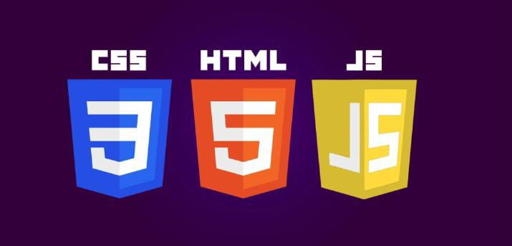
TECHNOLOGY USED
HTML: Provides the structure of the game.
CSS: Styles the interface and adds visual appeal.
JavaScript: Implements game logic, randomization, and interactivity.
Audio Files: Background music and sound effects for engagement.

Slide 5
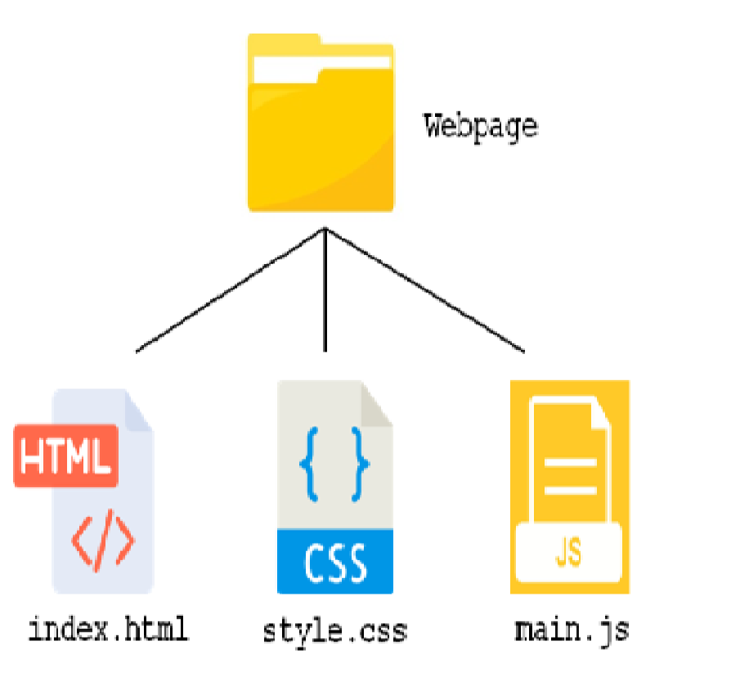
PROJECT STRUCTURE
index.html
The main file that holds the HTML structure of the game.
Contains elements like reels, buttons, and user interface components.
Integrates external styles (style.css) and scripts (script.js).
style.css
Defines the visual appearance of the game.
Includes custom styles for the reels, buttons, and other UI elements.
Helps in ensuring a responsive and aesthetically pleasing design.
script.js
Handles all the interactive features and game logic.
Includes functions for spinning reels, calculating wins/losses, managing balance, and integrating sound effects.
sounds/ Directory
Contains audio files like win.mp3, lose.mp3, and background music.
Enhances player experience with sound effects for winning or losing.
assets/ Directory
Stores additional resources like images or icons for the game.
May include symbols for reels or any branding/decoration graphics.
Customizability
New symbols, sounds, or styles can be added by simply updating respective directories and files.
Foundation for Advanced Features
The structured organization supports easy integration of additional features like payment gateways, crypto integration, or backend services.
.

Slide 6
GAME WORKFLOW
1
Deposit Money: Player enters an amount and clicks "Deposit."
2
Place Bet: Set a bet amount within the balance.
Spin the Reels: Reels display random symbols.
3
Win or Lose: Matches determine rewards; balance updates accordingly.

Slide 7
LEARNING OUTCOMES
1
Applying JavaScript to handle real-world interactivity.
2
Managing the DOM and integrating audio
Debugging and improving user experience.
.
3
Enhancing the game's visuals with CSS animations.

Slide 8
FUTURE ENHANCEMENTS
Animations: Add spinning effects to the reels.
Leaderboards :Track and display high scores.
Jackpot Feature : Introduce progressive jackpots.
Multiplayer Mode: Allow multiple users to compete.

Slide 9
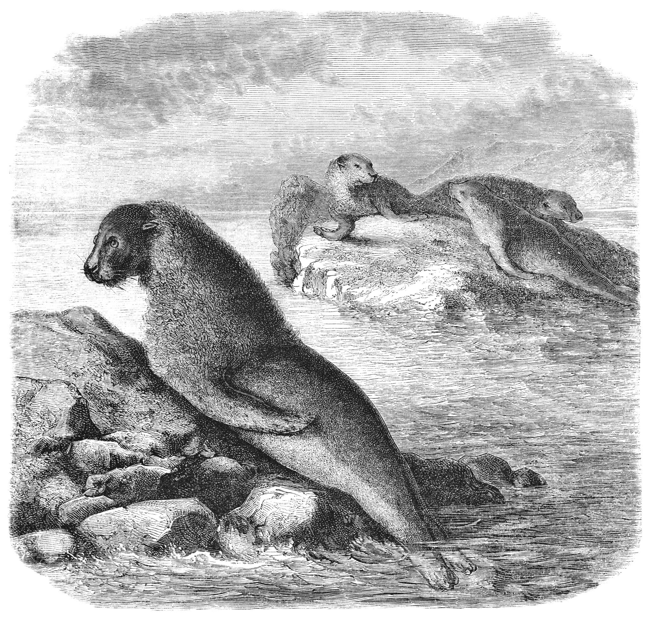
THANK YOU

